Slide 1
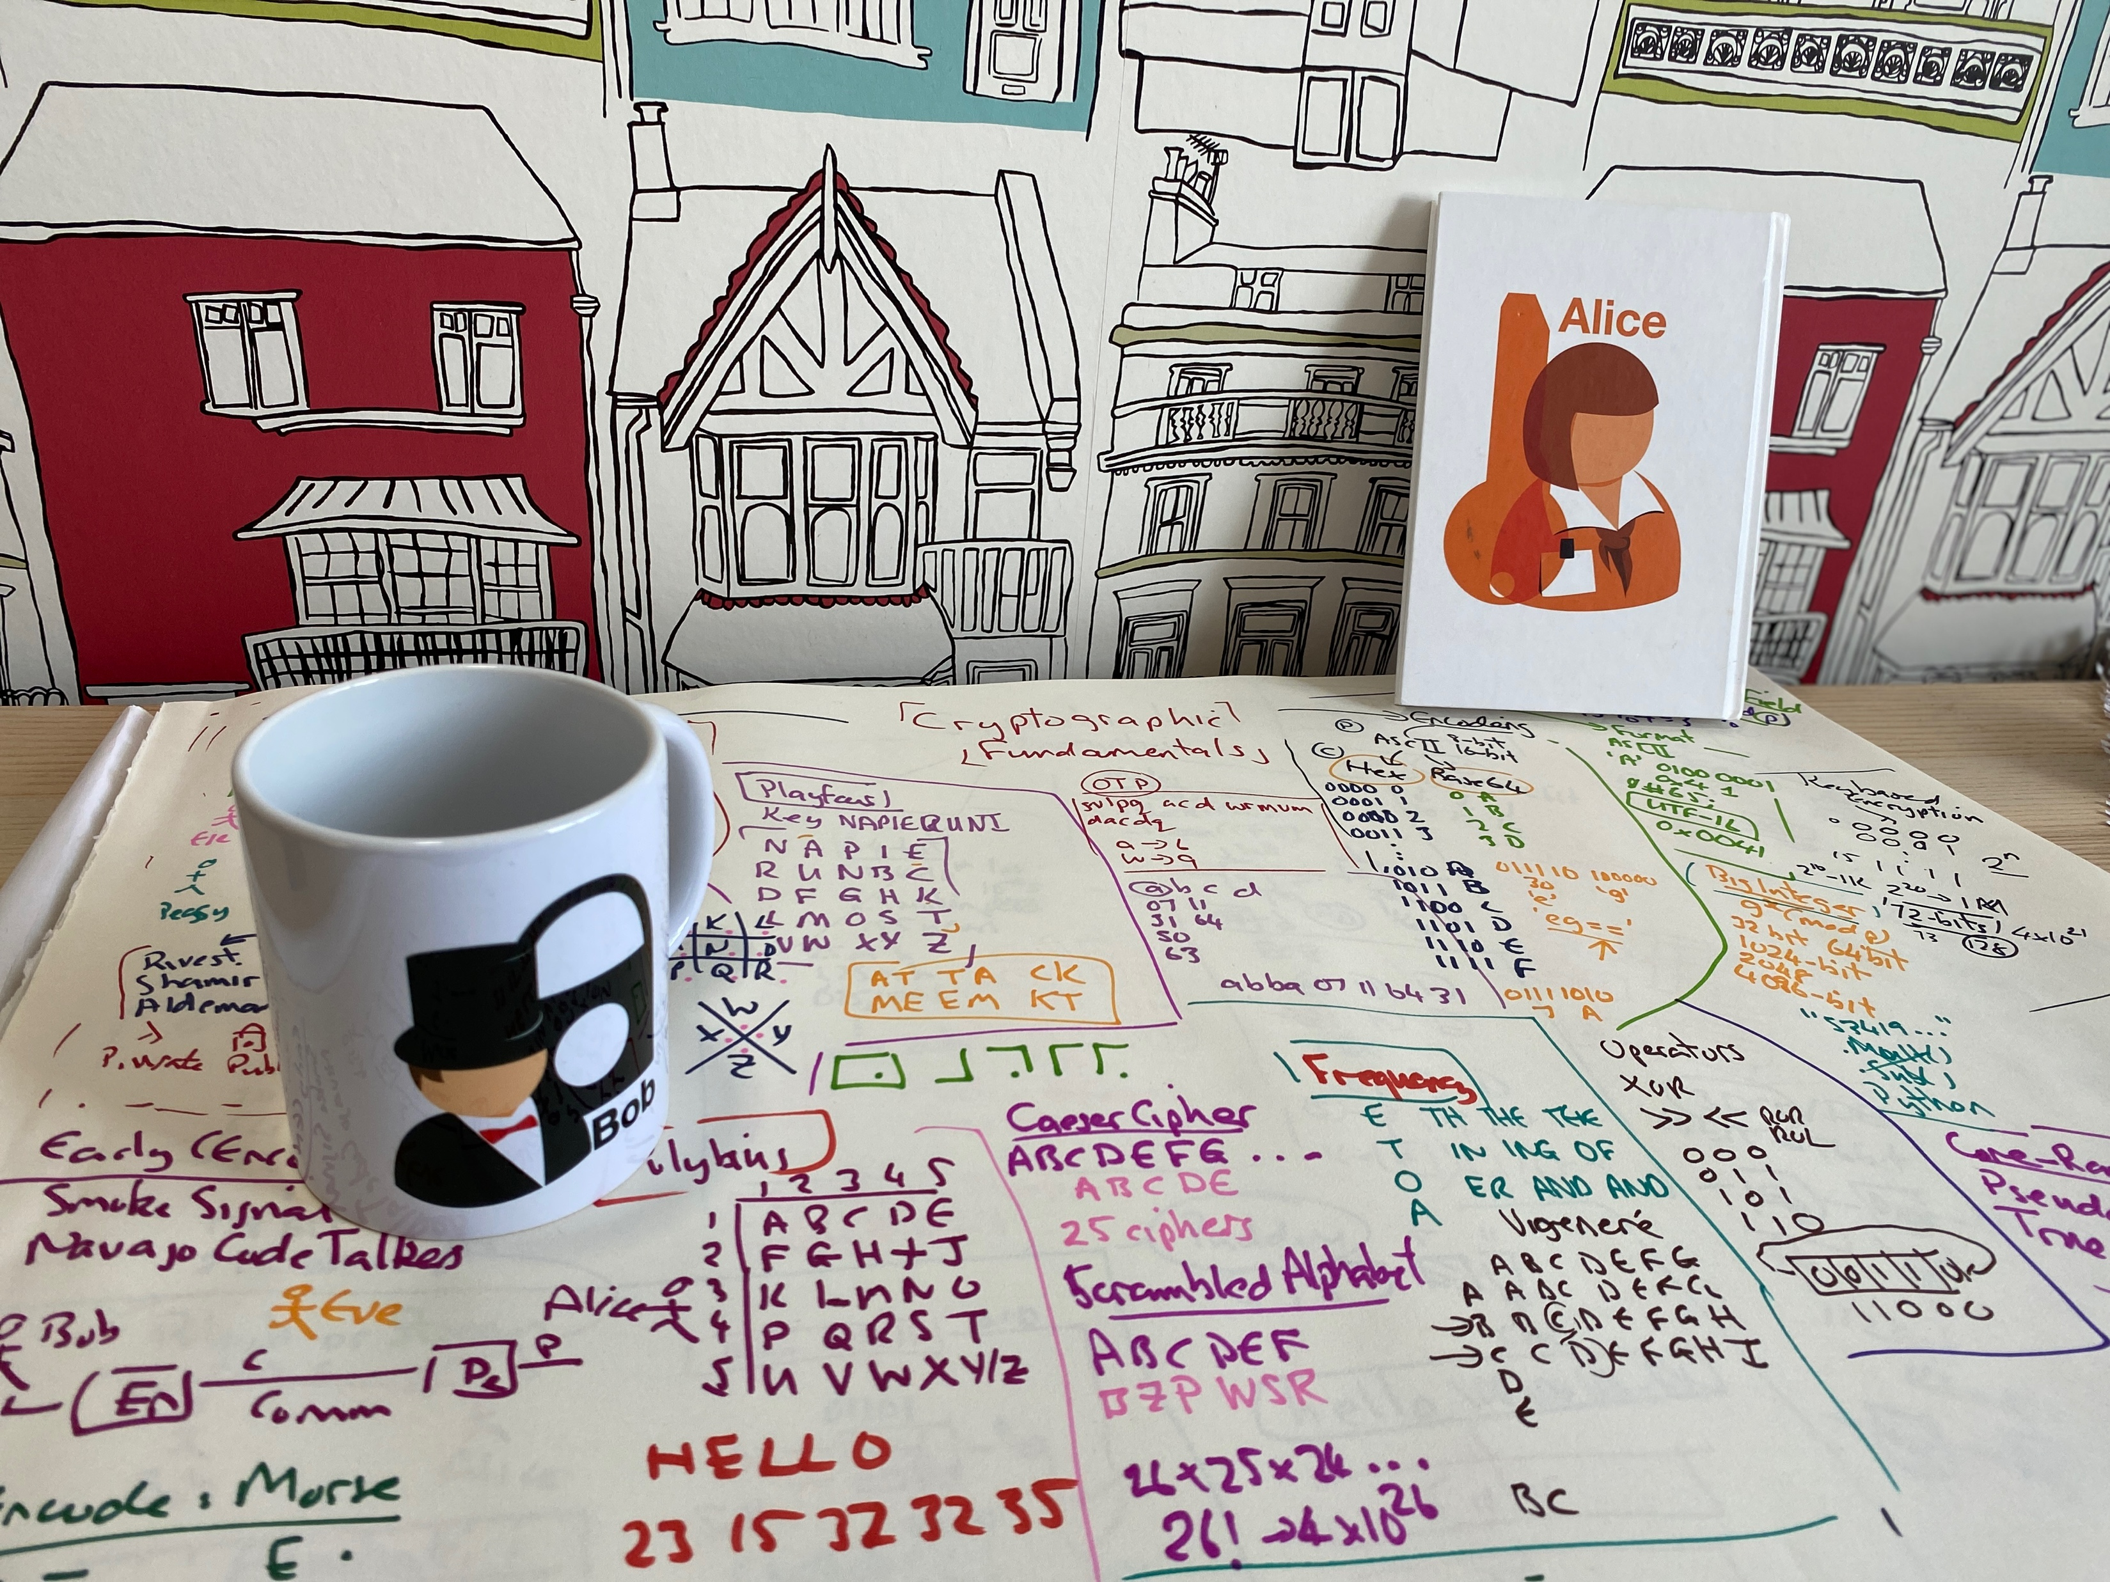
Introduction
Light-weight crypto.
Quantum-robust crypto
Tokenization.
Zero-knowledge.
Homomorphic Encryption.
zkSnarks, Range-proofs
Prof Bill Buchanan OBE https://asecuritysite.com/light

Slide 2

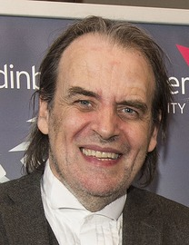
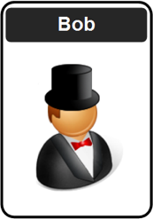

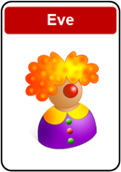
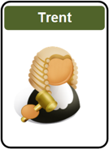
Professor Bill Buchanan OBE. Research into cryptography, blockchain and identity. Leads with Blockpass ID Lab.
Twitter: @billatnapier Web: asecuritysite.com

Slide 3
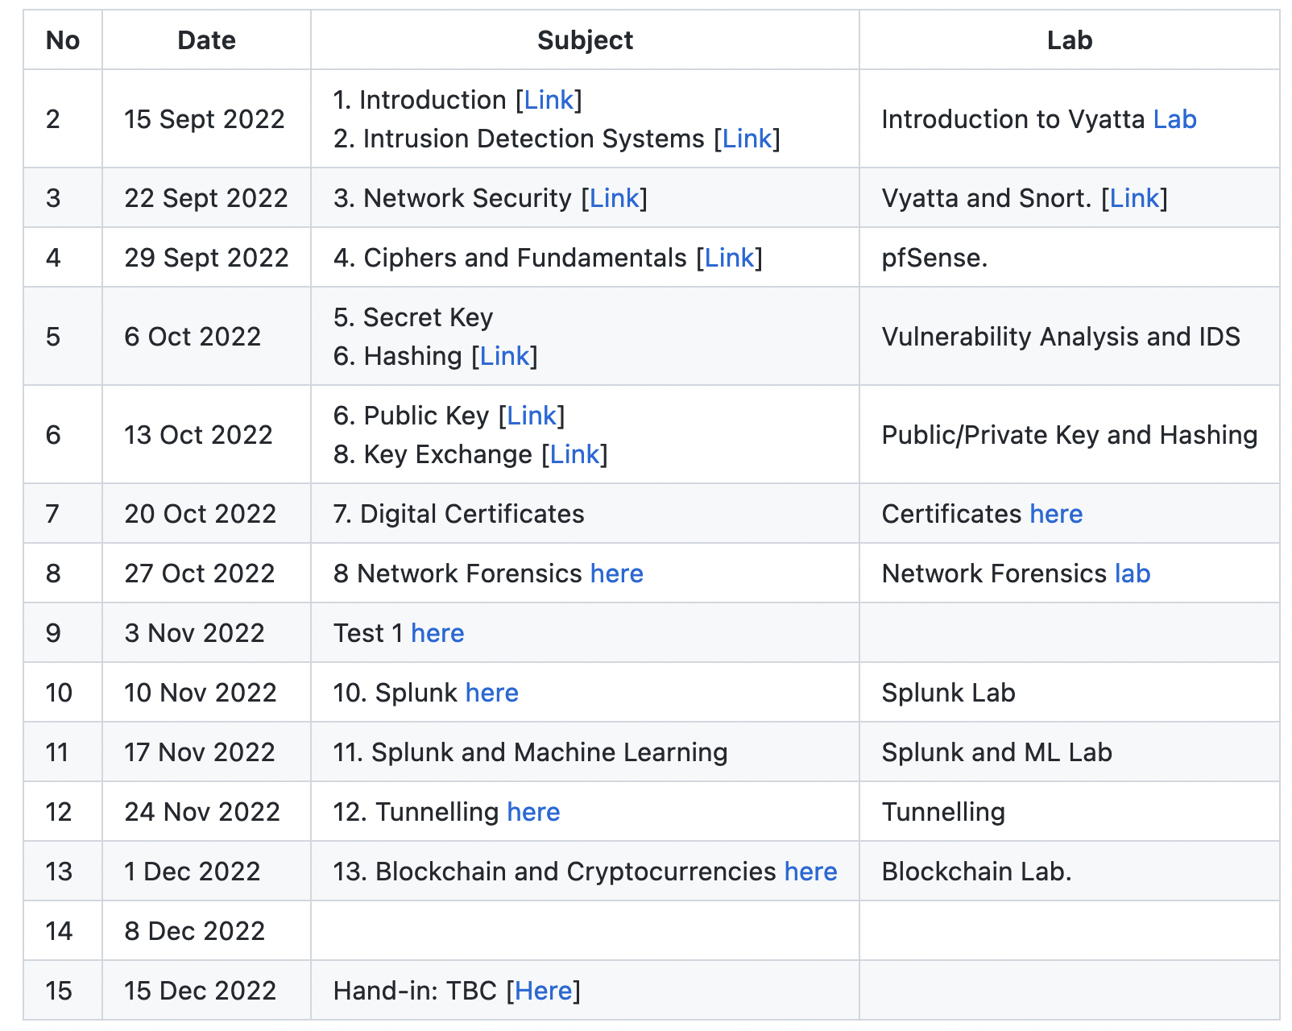
git clone https://github.com/billbuchanan/csn09112

Slide 4
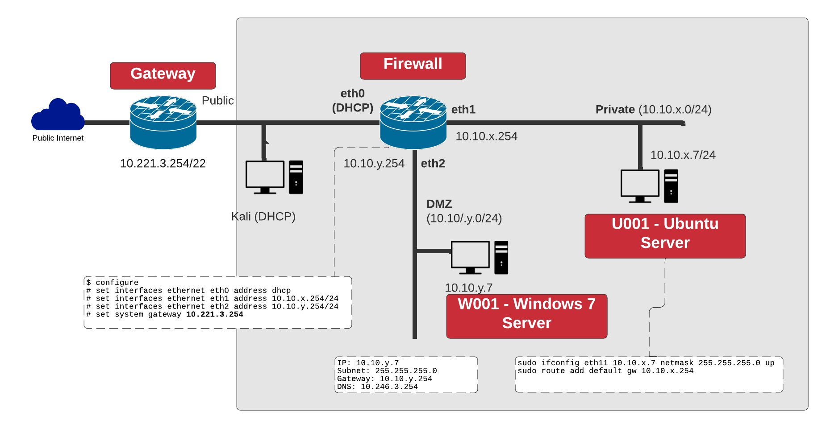

Slide 5
Security Taxonomy
Light-weight crypto.
Quantum-robust crypto
Tokenization.
Zero-knowledge.
Homomorphic Encryption.
zkSnarks, Range-proofs
Prof Bill Buchanan OBE https://asecuritysite.com/light

Slide 6
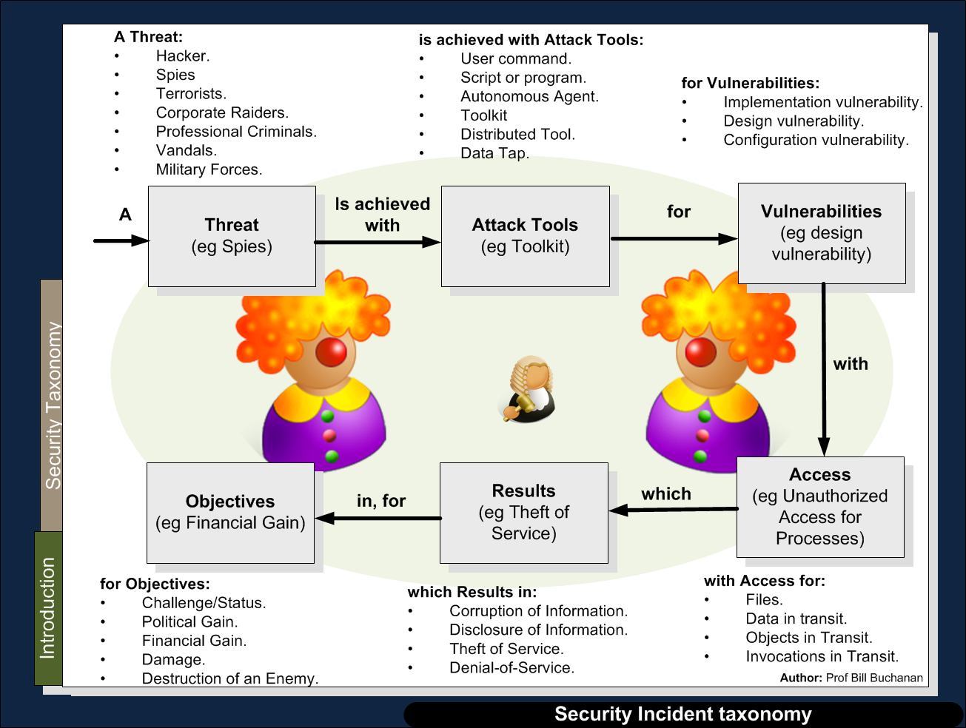

Slide 13
Introduction
Light-weight crypto.
Quantum-robust crypto
Tokenization.
Zero-knowledge.
Homomorphic Encryption.
zkSnarks, Range-proofs
Prof Bill Buchanan OBE https://asecuritysite.com/light

